Slide 1

GeDinfo Soc.Coop.
School Tutor: M. Silva
1°Period 2°Period
15-05-2017 11-09-2017
11-06-2017 22-09-2017
Time schedule: 09:00 – 18:00

Slide 2

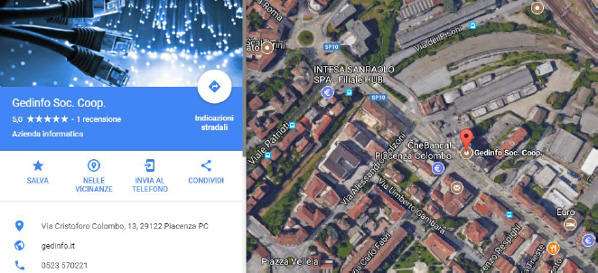
GeDInfo is an informatic company that offers informatic services.

Slide 3




Wordpress,Plugins and search via Chrome
Web site creation tools → WordPress and its Plugins
What is a Plugin?
It’s a non autonomous program that interacts
with another program for extend its original features.
Search ability increased → Chrome

Slide 4


My first experience
Difficult to integrate myself into the company
Relation with Company Tutor’s and job’s request

Slide 5



My work and tasks
Different tasks required different time
because they could be more or less complex
Respect the working times
Evaluation of work by my tutors

Slide 6
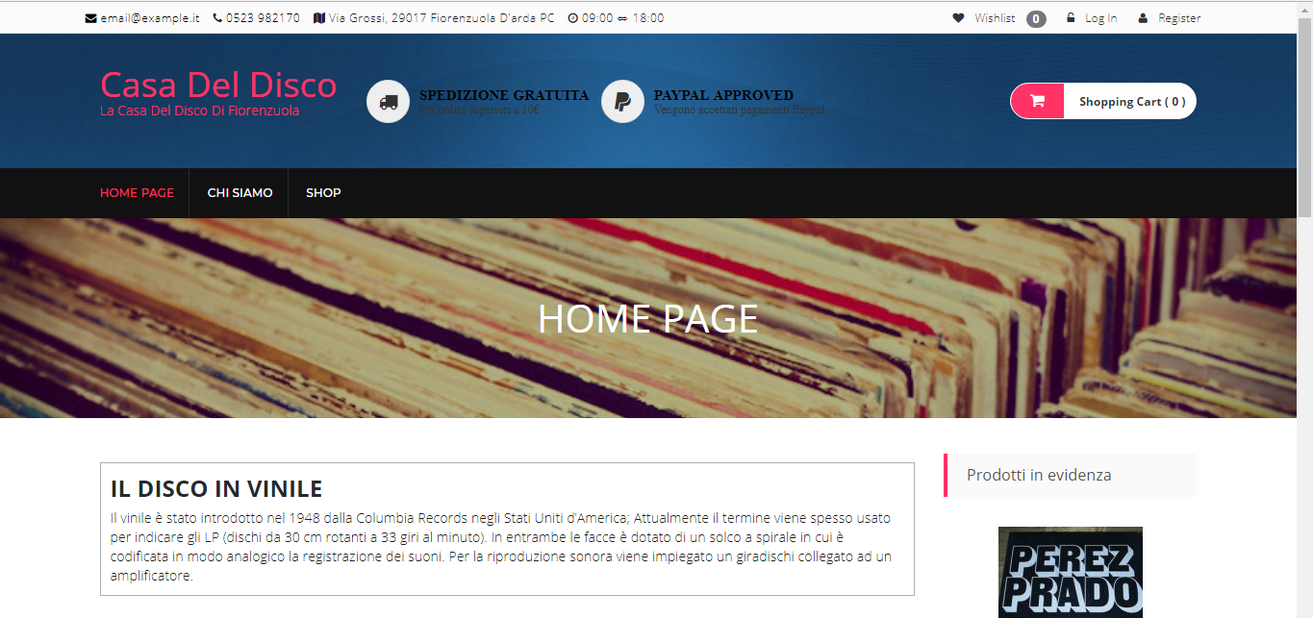
La Casa del disco
My first integral website was “La Casa del disco”, an eShop that sells Vinyls

Slide 7
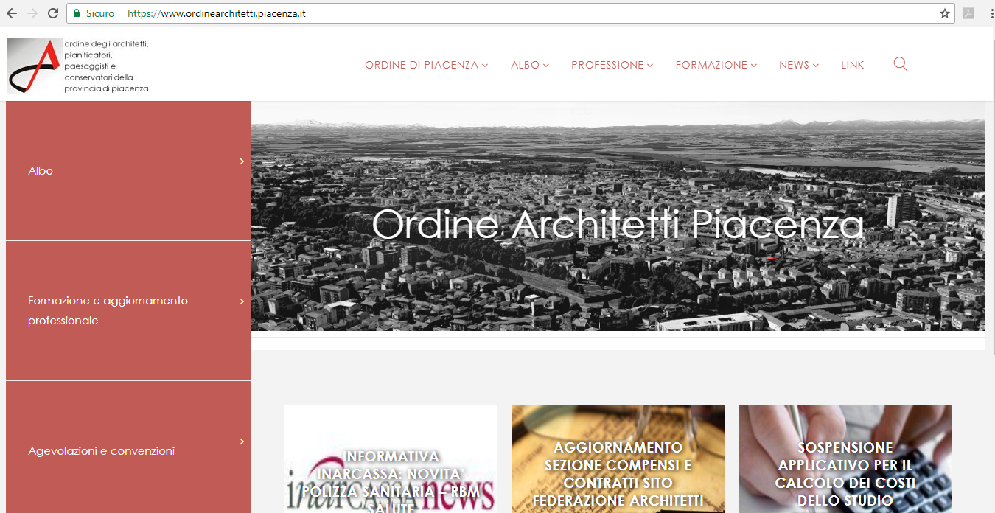
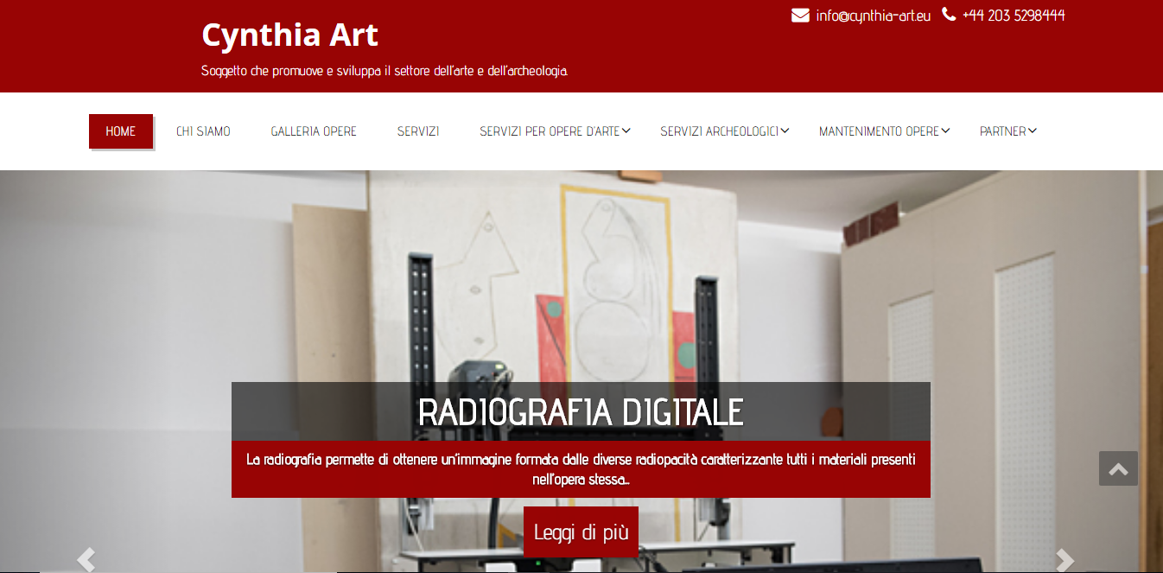
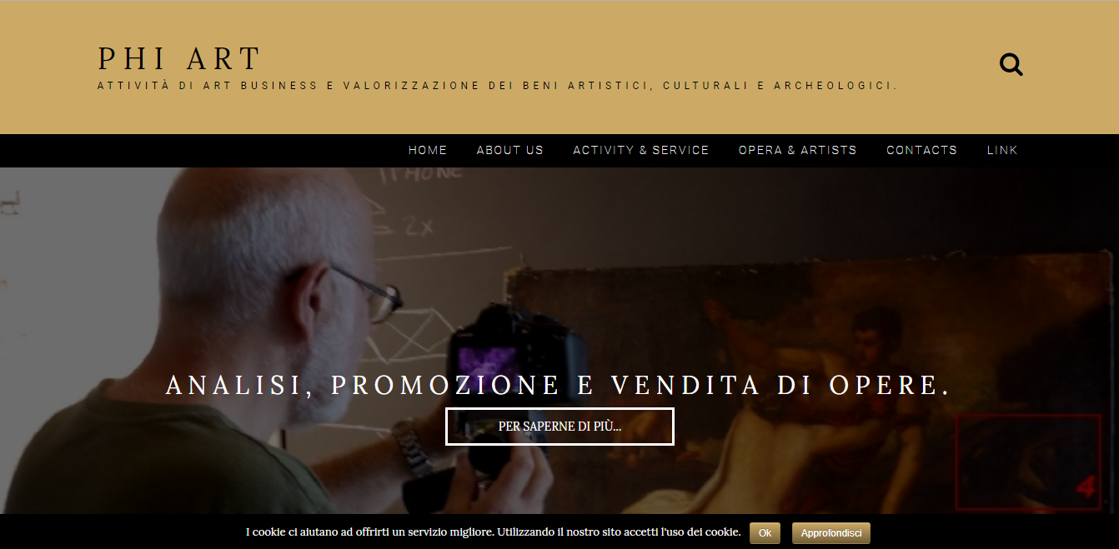

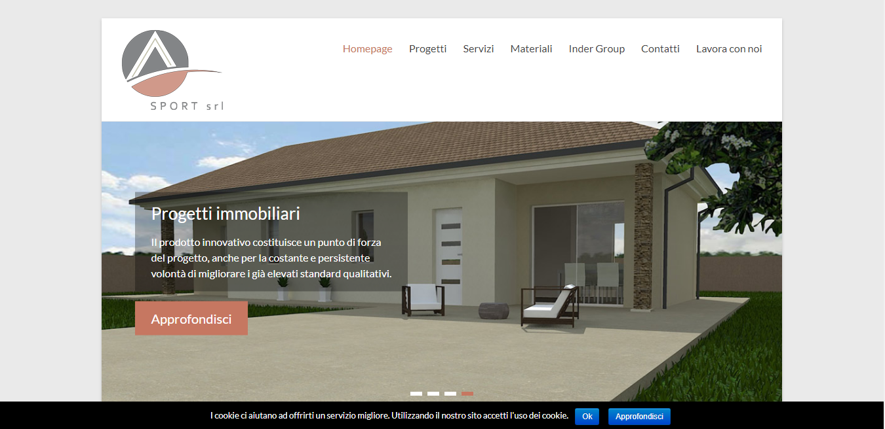
Other Project
https://www.web-sport.it
https://www.prodigy-group.net
https://www.cynthia-art.eu
https://www.phiart.eu
http://www.ordinearchitetti.piacenza.it

Slide 8

Project a completely autonomous web site
Complete and very instructive

